Slide 1










A Pitch by
All slides are animated and will prompt you to continue
(click to continue)

Slide 2








DissociaFred is a conjunction of the words
Which means to disconnect
or
for short
This word for us is short for
formally known as Multiple Personality Disorder
This is a mental health disorder where one being has a disruption of identity (2+ distinct personalities that differ from one another), gaps in memory (caused from a personality being pulled away from reality), and causes the person significant distress or impairment (it gets in the way of living life).
Think of DID as a broken mirror; it is one personality that breaks into pieces and becomes fragments of a whole.
DID is primary due to childhood trauma because children have difficulty fighting back or get away from their abusers (Click to Continue)
This causes the child to freeze -breaking the mirror- and pull inward, creating distance from what is happening as well as separate the child from the pain they were feeling. The new personality taking the child's place then holds onto that experience instead of the child.
(Click to Continue)
(click to continue)

Slide 3


EVERYONE SHUT UP!
Thank you
There’s too many of us to name in this little montage though
She’s not that great
Well you’re not
Uhh
.
.
.
The
GRAND FROMAGE
The other conjunction word is
The STAR of the Show
We are doing this my way.
We’ve wasted too much time cause of ya’ll
Our Main Character
I’m sorry about that, we are ready now. My name is Bo, I will be your navigator
HEY!
_____________
Please press the left button to continue
Our HEROINE
Yeah, why are we still talking about Winni?
Maybe we shoul
Our Leading Lady
I WANNA GO!!
Who should go first?

Slide 4



I think it would be best if we only introduce ourselves, ya?
Cool. Do ya wanna introduce yourself?
A pleasure to meet you, I am a sophomore at Timberland State University. Currently 19 years old and don’t know what I want to do yet career wise
And that’s pretty much it
Sorry about earlier, it is hard to keep a handle on everyone in our system
I’m the original personality and the one fronting 90% of the time. I am the host of our system.
Yeah sure
Sounds like a plan
Just call me
Good job, good job, okay I’m up
(click to continue)

Slide 5



Jeez… anyways
Happy now?
. . .
Alright, Well, I’m
Very much so
Hey, c’mon
So, just call me Bo. I look a lot like this dude. Charming right, I know. I’m 21 and our systems primary protector.
I spend most of the time inside nowadays. Things are pretty chill at this college. It’s been soo boring lately so I’ve been confronting more
Yeah I need you to stop
. . .
My job is to keep the body safe internally and externally. I manage and regulate most things around here.
Yah, yah, yah. Maybe I wouldn’t if you dumped that doushe
Mhm.. that’s what I thought. But yeah, I’m pretty much the first responder.
Yeah I got it
It’s on the next slide
That’s it for now, do ya still got that map you drew?
Sweet, alright folks, next slide if you please

Slide 6
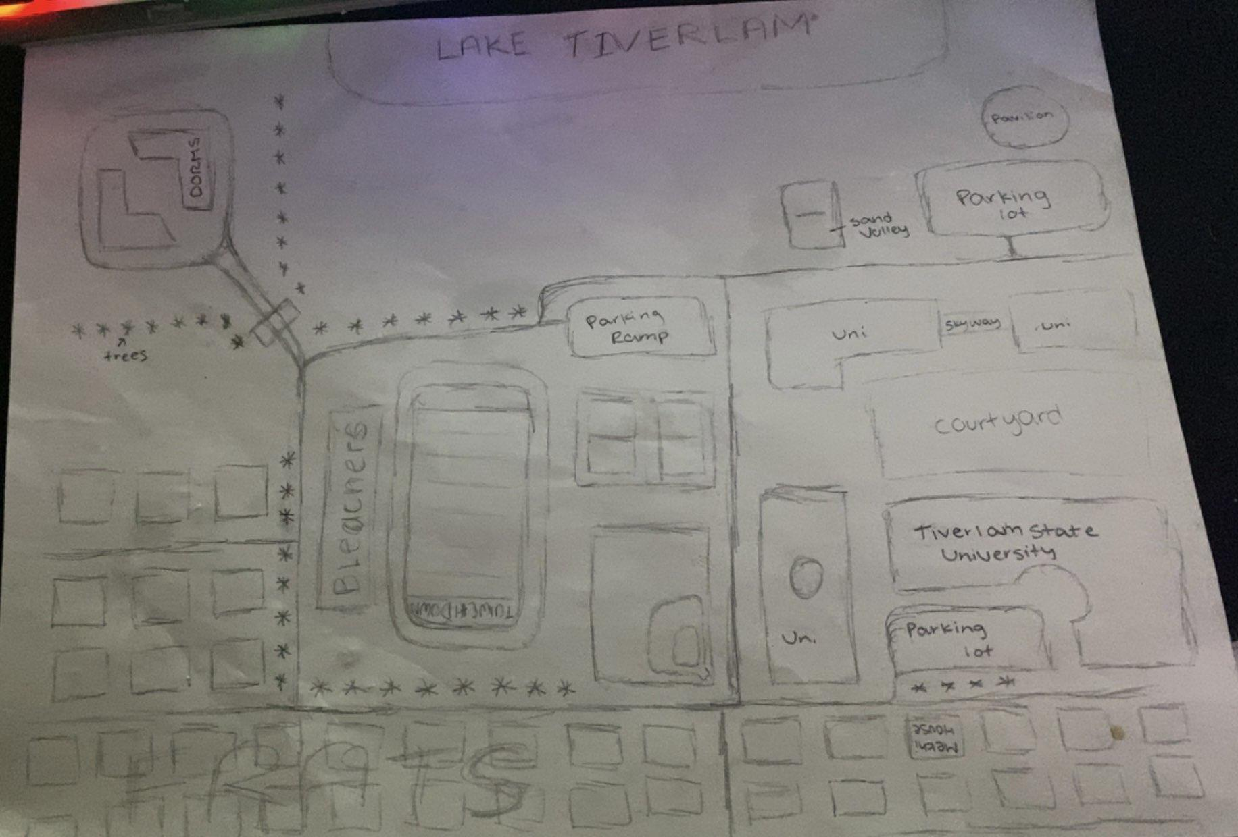

This is the
START
HERE
This will be about the first 30 minutes to an hour of gameplay
You are in full control of what happens between
You will start the game
And end up
Due to events, you will be playing as me so don’t do anything stupid, got it kid.
and
HERE
FINISH
Oh! Ok, not bad not bad
(click to continue)

Slide 7

(click to continue)
Alright that’s all we have on our end
Thank you for listening to us. I hope you find some joy stepping into our shoes
I’m handing ya over to the Amentalio CEO
Thank you Bo and Winni, appreciate you doing this for us!
Why did we create

Slide 8
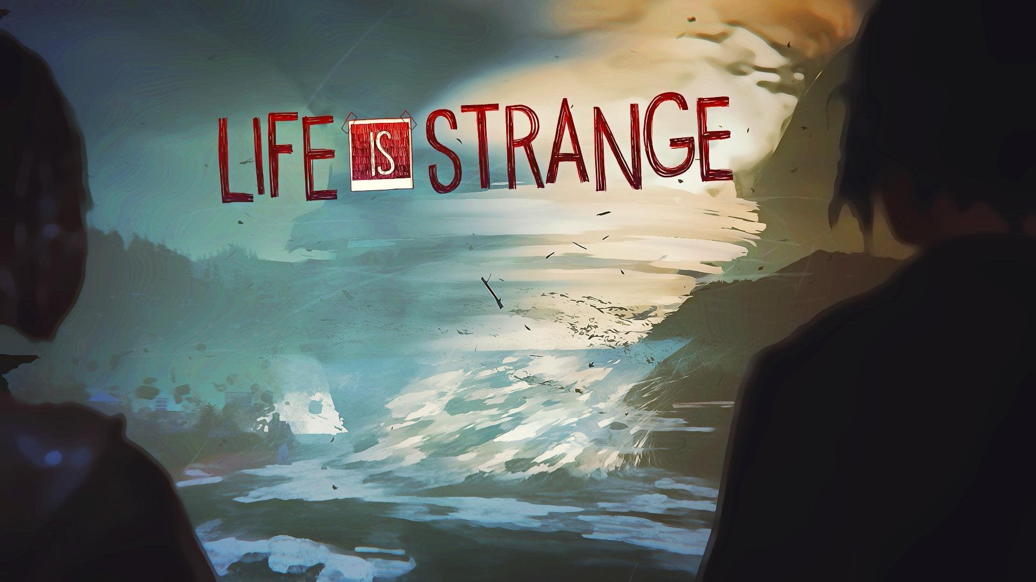

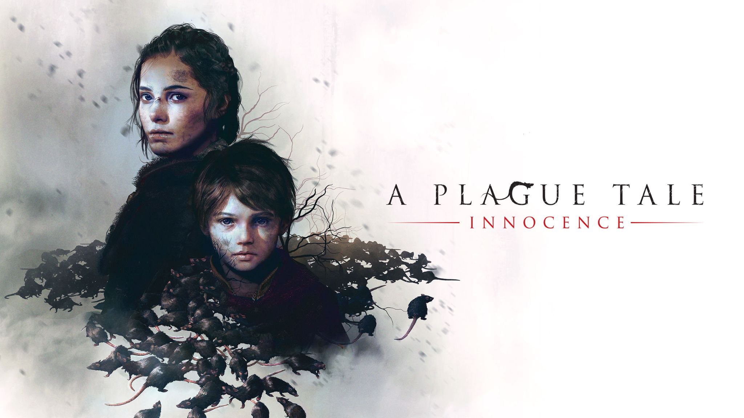
We were heavily influenced by games like
and
(click to continue)

Slide 9



This game was specifically made to introduce people to the mental condition that is DID and what it is like to live with it
DissociaFred is a butterfly effect game that lets players explore the Timberlam State University campus and everything they have to offer. It is also a life simulation as one could live through these real potential situations
The game will give you clues as to what your next objective is as well as small task you can do to interact with other NPC’s and build relationships, or break them
We want to make the game feel as real as possible so their will be some points in the game where you have limited to no control of the gameplay and will have to sit there for the ride
(click to continue)

Slide 10
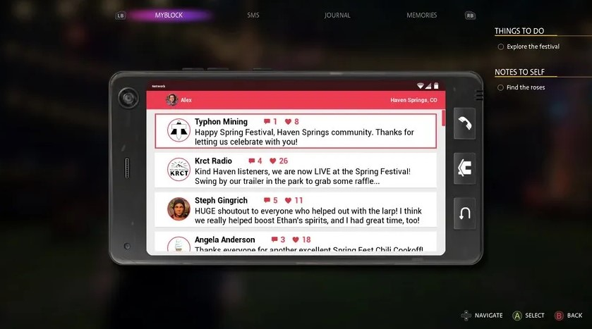

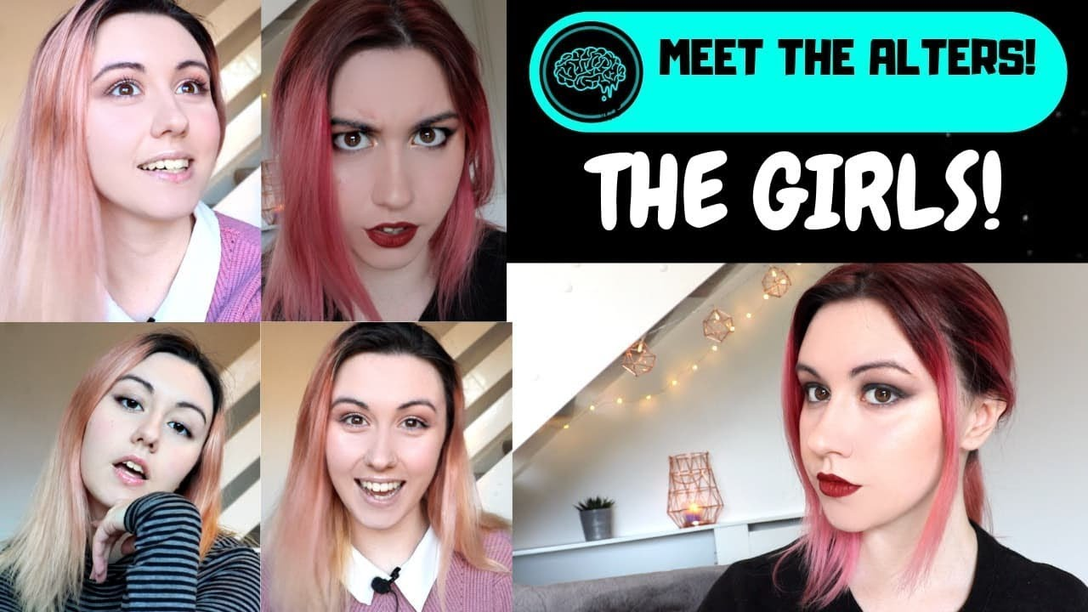
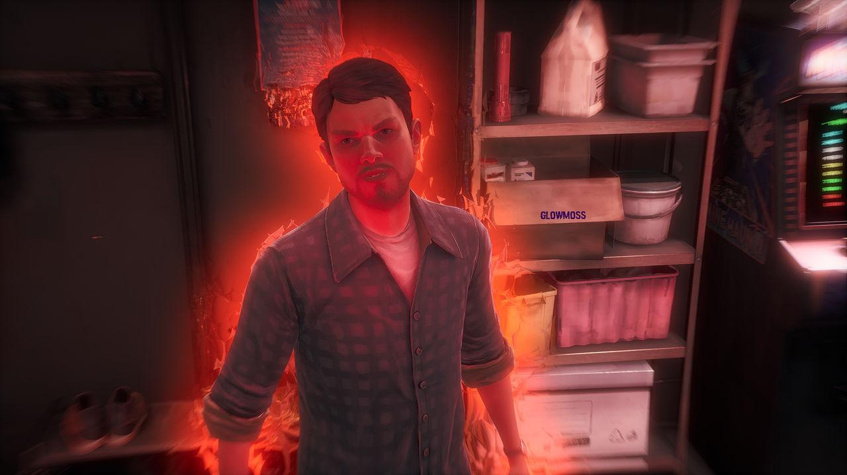
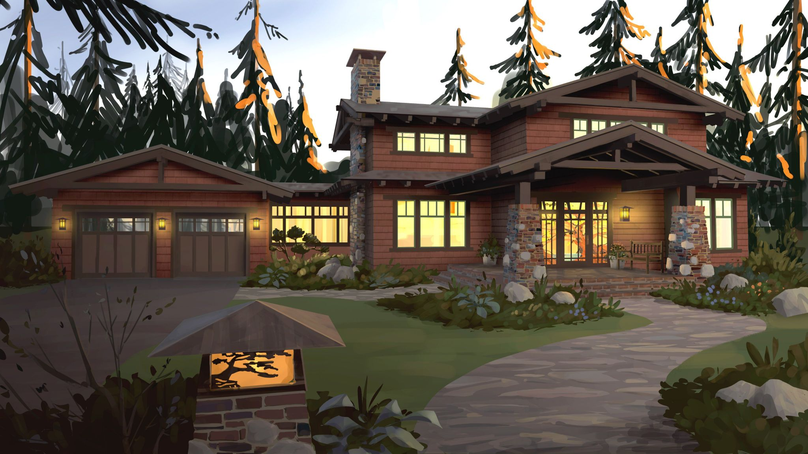
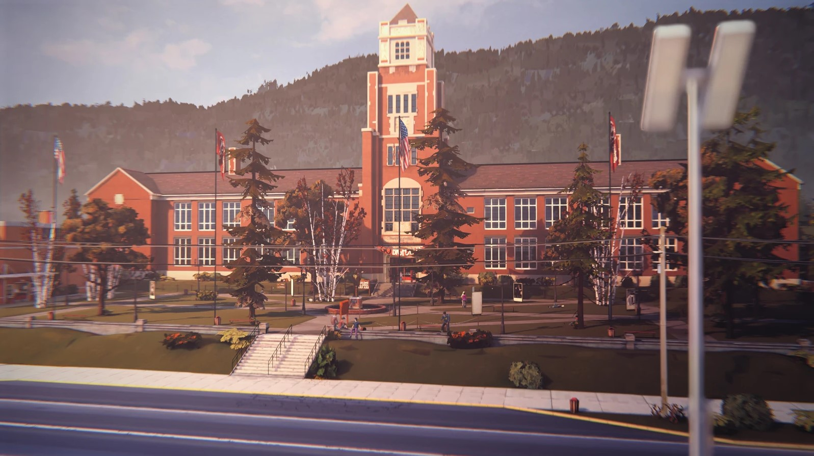
(click to continue)

Slide 11
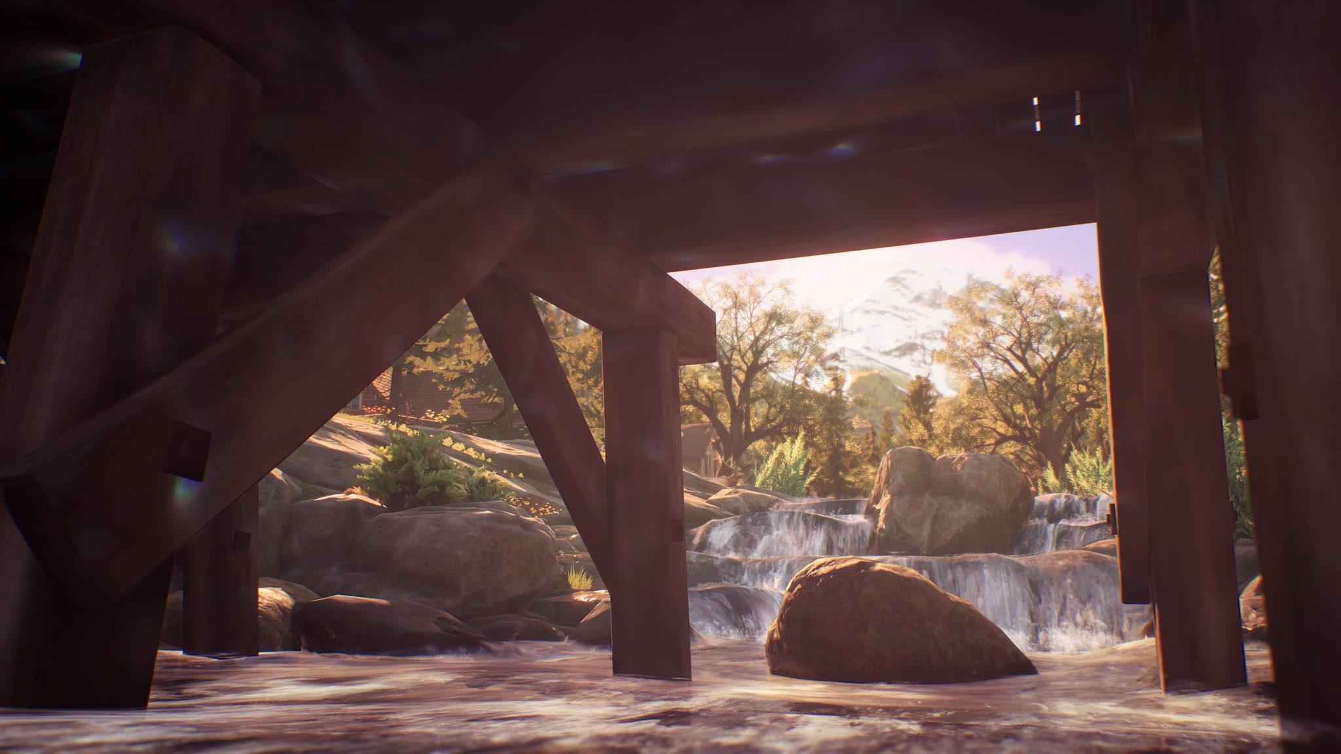
(click to continue)
A Possible Front Screen
Continue
Play episodes
Help & Options
Amentalio Account
Downloadable content

Slide 12





The fate of the game is in your hand
Action-Adventure
Simulation
Psychological Thriller
Strategy
But just know
Interactive Film
Narrative Adventure
(click to continue)

Slide 13
Facts About
Amentalio was created in the middle of March 2023. While Amentalio Entertainment is quite new, DissociaFred has been on our mind for the last seven years
We strive to make hearts flutter here and give our players a worthwhile experience that we hope they will never forget
Amentalio was named after watching my grandpa continuously suffer with Alzheimer's as his memory slips further every years. It made me realize that I do not want to forget the things I have done in my lifetime, so writing stories for games for everyone to enjoy sounds like an honor, as no game ever truly dies
(click to continue)

Slide 14


(click to continue)
Relies on the company name to convey information
Uses cooler colors
We want to give the best immersive interactive story one could give, some games will need to be rated and give correct warnings
Our games would be best on console or PC

Slide 15



36% of gamers in the U.S. are between the ages of 18-34
More people rather watch someone [Youtuber] play a scary game than play one themself
This is still good as it can bring more attention to your game and bring in people to play the next game
Action-adventure and simulation video games are ranked second and third most played among all ages
(click to continue)

Slide 16
Thank you!
We at
Would like to thank you for your time
You take care now~
Yes thanks again ya’ll
Please email us with any questions you may have!

